Slide 1
Travel Agency Fusion
Ivan Petrov https://github.com/Nv4n/travel-agency-fusion

Slide 2
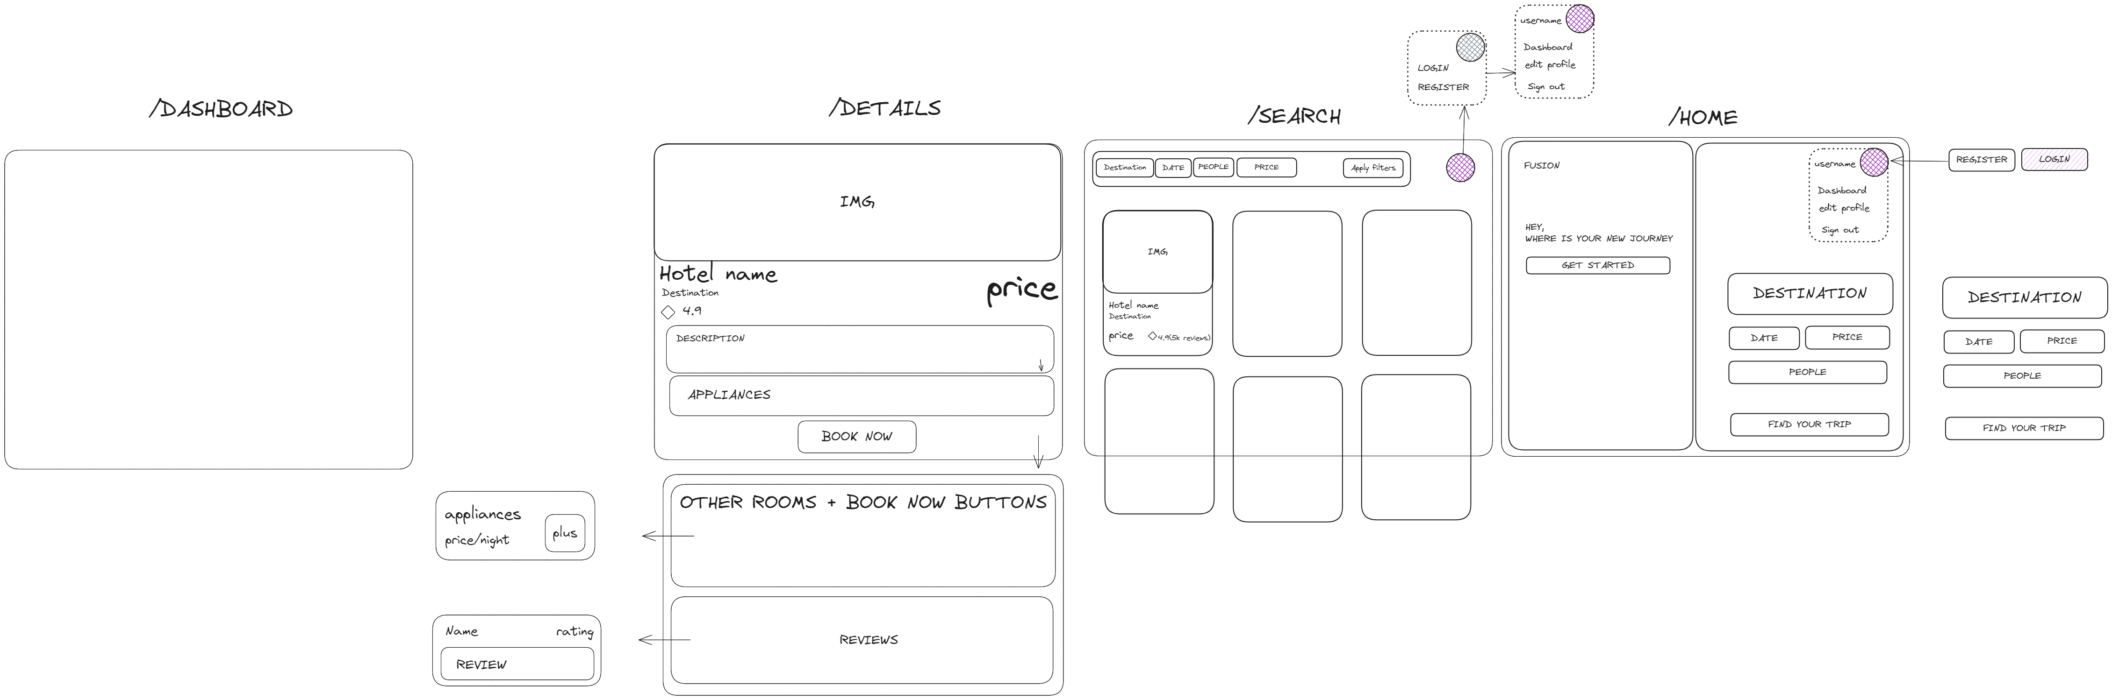
Mockup design

Slide 3
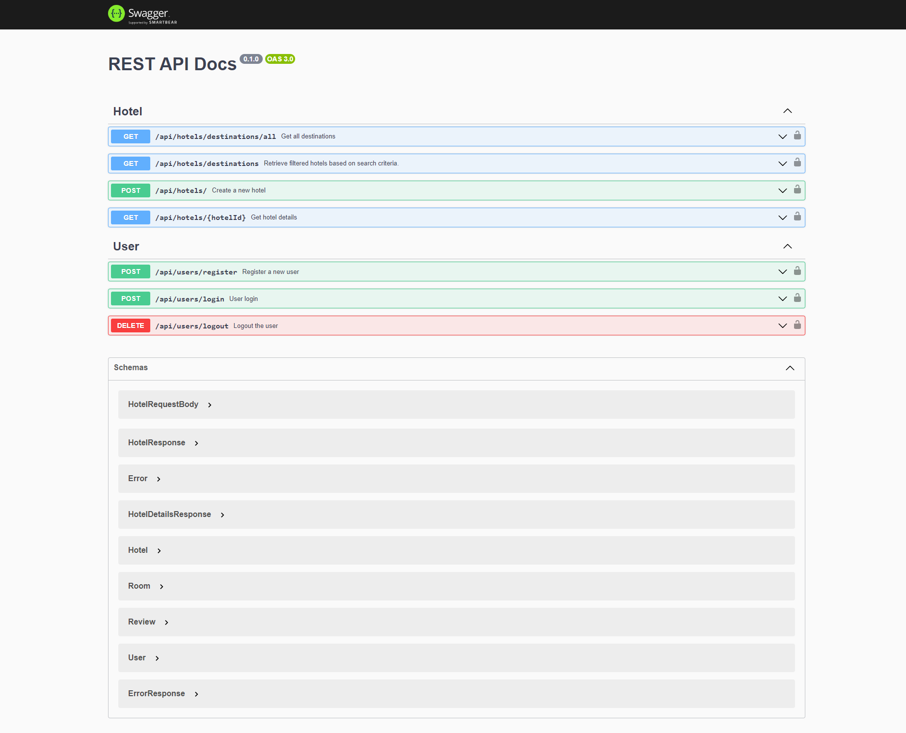
Api Overview

Slide 4
Authorization
JWT Access Token
JWT Refresh Token

Slide 5
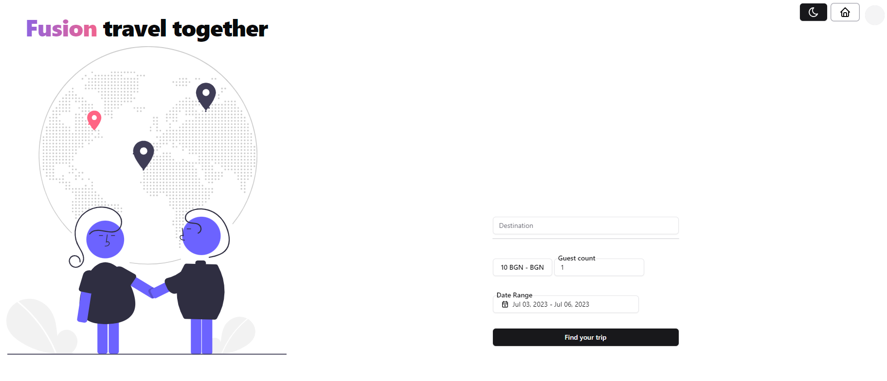
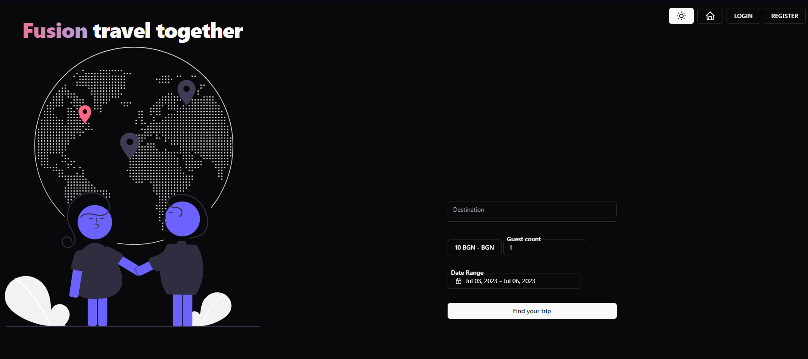
Realization: Theme changer

